Slide 1


Insight Stream: Navigate the News Landscape
This presentation delves into the intricacies of today’s news environment, highlighting essential strategies for effectively navigating and interpreting information. It underscores the crucial role of critical thinking in evaluating news sources and identifying potential biases, empowering individuals to become informed consumers of news.

Slide 2




Understanding News Sources
News sources vary widely from traditional media to online platforms. It's crucial to evaluate their credibility and reliability. Additionally, using fact-checking resources can help clarify misinformation.
Types of News Outlets
Traditional newspapers, TV stations, online platforms, and social media
Credibility Assessment
Consider track record, ownership, and editorial standards
Fact-checking Resources
Websites like Snopes and FactCheck.org

Slide 3





Identifying Bias in News
Balanced Reporting
Seek out diverse perspectives on the same issue by consulting multiple sources. This approach helps provide a more rounded understanding of complex topics and reduces the risk of being misled.
2
Recognizing Bias
Every news outlet has potential biases influenced by political, corporate, or ideological factors. It's crucial to identify these biases to analyze the information critically.
1
Emotional Language and Framing
Watch for loaded language or framing techniques that might provoke emotional reactions. Understanding these tactics can help maintain a more objective viewpoint.
3

Slide 4

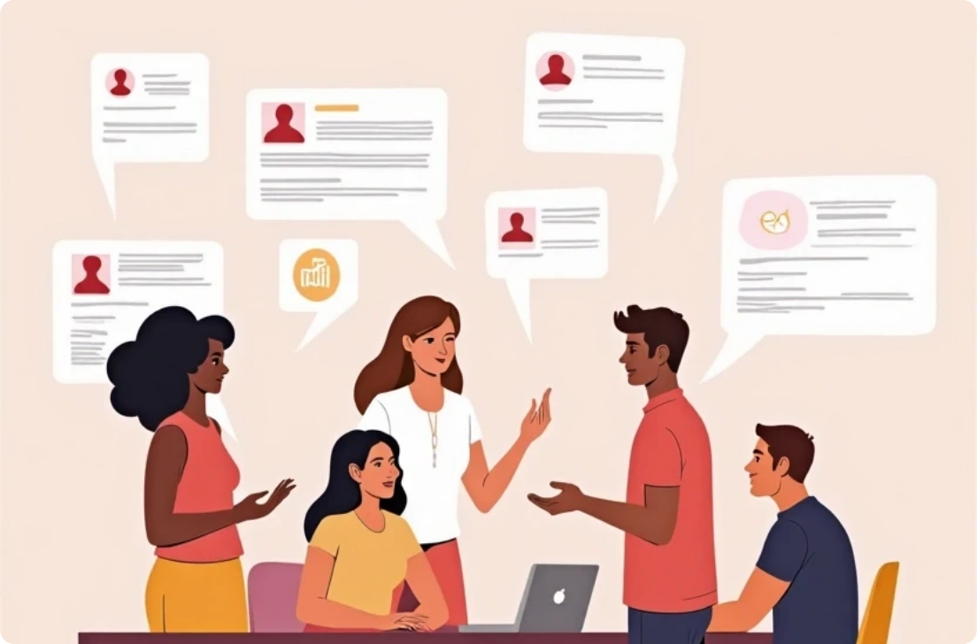

The Role of Social Media
Dissemination of News
User Responsibility
Engagement with Journalists
Social media rapidly shares news, but also spreads misinformation. Verification is key.
Users must be mindful of their sharing habits and source credibility for informed discussions.
Journalists use social media for insights; engaging can provide deeper context and diverse views.

Slide 5


Learning to Analyze News Critically
Critical Thinking Skills
Creating a Personal News Diet
Practical Exercises
Cultivate critical thinking by questioning the motives behind news stories.
Regularly engage in exercises like summarizing articles and discussing news with peers.
Develop a balanced 'news diet' by consuming a mix of sources across the political spectrum.

Slide 6




Future of News Consumption
Emerging Technologies
Innovations like AI in news reporting raise ethical questions regarding accuracy and bias, emphasizing the need for understanding technological impacts.
Evolving Formats
Community News Initiatives
Podcasts, video news, and newsletters signal a shift in how audiences consume news, offering more engagement opportunities while requiring scrutiny for authenticity.
Local journalism is evolving with transparency-focused initiatives, which can bolster local democracies and informed citizenship.
2
1
3

Slide 7





Conclusion
1
Empowered Consumers
Individuals must take responsibility for how they consume and share information.
2
Ongoing Education
Continuous learning about media literacy and critical thinking is essential.
3
Next Steps
Evaluate personal news consumption habits and commit to an informed approach.

